Slide 1
The 8051 Microcontroller

Slide 2
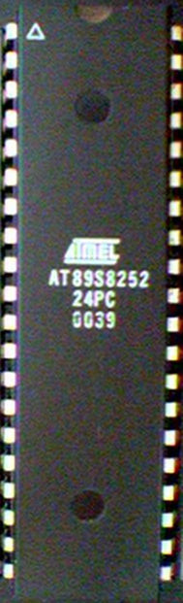
8051 Basic Component
4K bytes internal ROM
128 bytes internal RAM
Four 8-bit I/O ports (P0 - P3).
Two 16-bit timers/counters
One serial interface
CPU
RAM
ROM
A single chip
I/O Port
Serial COM Port
Microcontroller
Timer

Slide 3
Block Diagram
External Interrupts
Interrupt
Control
4k
ROM
128 bytes
RAM
Timer 1
Timer 2
CPU
OSC
Bus
Control
4 I/O Ports
Serial
P0 P2 P1 P3
TXD
RXD
Addr/Data

Slide 4
Other 8051 featurs
only 1 On chip oscillator (external crystal)
6 interrupt sources (2 external , 3 internal, Reset)
64K external code (program) memory(only read)PSEN
64K external data memory(can be read and write) by RD,WR
Code memory is selectable by EA (internal or external)
We may have External memory as data and code

Slide 5

Embedded System
(8051 Application)
What is Embedded System?
  An embedded system is closely integrated with the main system
  It may not interact directly with the environment
  For example – A microcomputer in a car ignition control
  An embedded product uses a microprocessor or microcontroller to do one task only
  There is only one application software that is typically burned into ROM

Slide 6
Examples of Embedded Systems
Keyboard
Printer
video game player
MP3 music players
Embedded memories to keep configuration information
Mobile phone units
Domestic (home) appliances
Data switches
Automotive controls

Slide 7
Three criteria in Choosing a Microcontroller
meeting the computing needs of the task efficiently and cost effectively
  speed, the amount of ROM and RAM, the number of I/O ports and timers, size, packaging, power consumption
  easy to upgrade
  cost per unit
availability of software development tools
  assemblers, debuggers, C compilers, emulator, simulator, technical support
wide availability and reliable sources of the microcontrollers

Slide 8
Comparison of the 8051 Family Members
ROM type
  8031 no ROM
  80xx mask ROM
  87xx EPROM
  89xx Flash EEPROM
89xx
  8951
  8952
  8953
  8955
  898252
  891051
  892051
Example (AT89C51,AT89LV51,AT89S51)
  AT= ATMEL(Manufacture)
  C = CMOS technology
  LV= Low Power(3.0v)

Slide 9
Comparison of the 8051 Family Members
89XX | ROM | RAM | Timer | Int Source | IO pin | Other
8951 | 4k | 128 | 2 | 6 | 32 | -
8952 | 8k | 256 | 3 | 8 | 32 | -
8953 | 12k | 256 | 3 | 9 | 32 | WD
8955 | 20k | 256 | 3 | 8 | 32 | WD
898252 | 8k | 256 | 3 | 9 | 32 | ISP
891051 | 1k | 64 | 1 | 3 | 16 | AC
892051 | 2k | 128 | 2 | 6 | 16 | AC
WD: Watch Dog Timer
AC: Analog Comparator
ISP: In System Programable

Slide 10
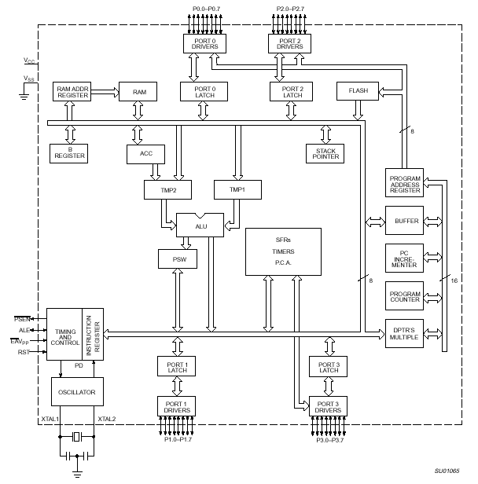
8051 Internal Block Diagram

Slide 11
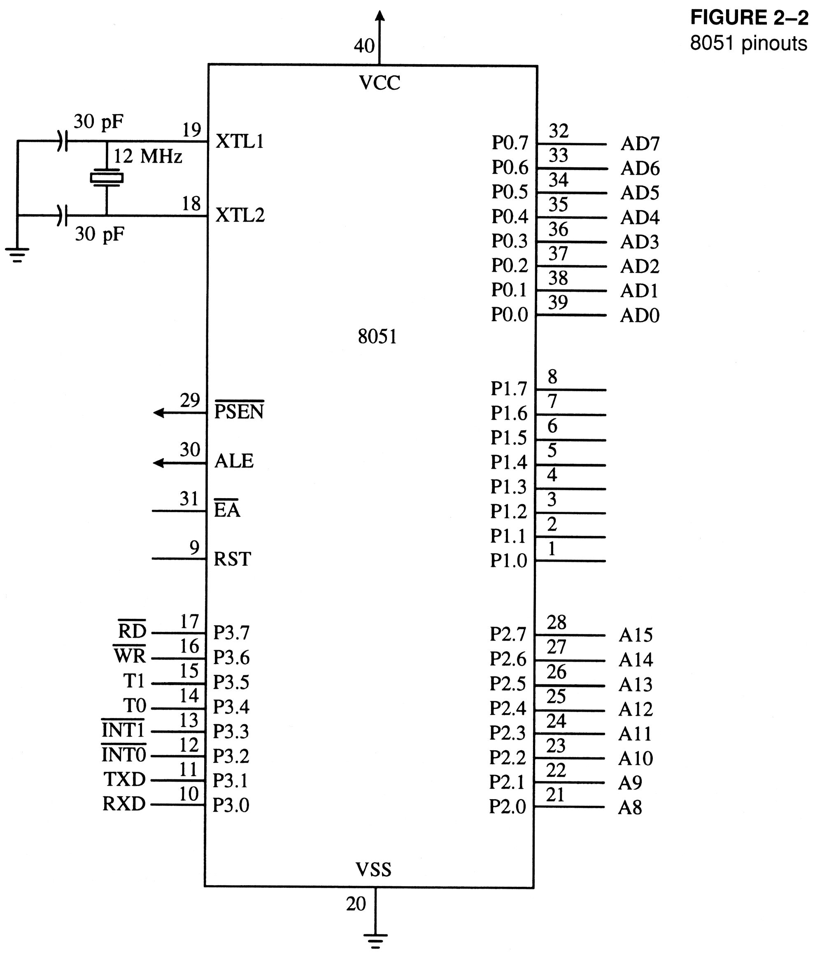
8051
Schematic Pin out

Slide 12
8051
Foot Print
P1.0
1
40
Vcc
P1.1
2
39
P0.0(AD0)
P1.2
3
38
P0.1(AD1)
P1.3
4
8051
(8031)
(8751)
(8951)
37
P0.2(AD2)
P1.4
5
36
P0.3(AD3)
P1.5
6
35
P0.4(AD4)
P1.6
7
34
P0.5(AD5)
P1.7
8
33
P0.6(AD6)
RST
9
32
P0.7(AD7)
(RXD)P3.0
10
31
EA/VPP
(TXD)P3.1
11
30
ALE/PROG
(INT0)P3.2
12
29
PSEN
(INT1)P3.3
13
28
P2.7(A15)
(T0)P3.4
14
27
P2.6(A14)
(T1)P3.5
15
26
P2.5(A13)
(WR)P3.6
16
25
P2.4(A12)
(RD)P3.7
17
24
P2.3(A11)
XTAL2
18
23
P2.2(A10)
XTAL1
19
22
P2.1(A9)
GND
20
21
P2.0(A8)

Slide 13
IMPORTANT PINS (IO Ports)
One of the most useful features of the 8051 is that it contains four I/O ports (P0 - P3)
Port 0 （pins 32-39）：P0（P0.0～P0.7）
  8-bit R/W - General Purpose I/O
  Or acts as a multiplexed low byte address and data bus for external memory design
Port 1 （pins 1-8） ：P1（P1.0～P1.7）
  Only 8-bit R/W - General Purpose I/O
Port 2 （pins 21-28）：P2（P2.0～P2.7）
  8-bit R/W - General Purpose I/O
  Or high byte of the address bus for external memory design
Port 3 （pins 10-17）：P3（P3.0～P3.7）
  General Purpose I/O
  if not using any of the internal peripherals (timers) or external interrupts.
Each port can be used as input or output (bi-direction)

Slide 14
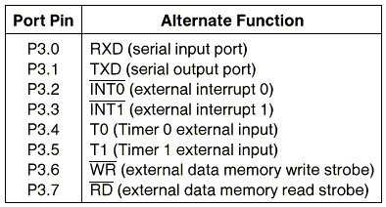
Port 3 Alternate Functions

Slide 15
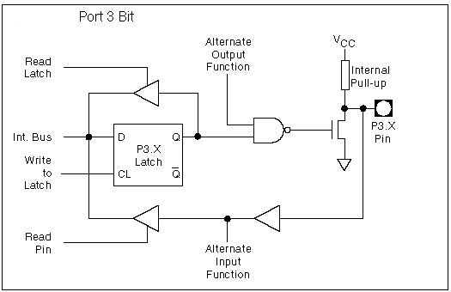
8051 Port 3 Bit Latches and I/O Buffers

Slide 16
Hardware Structure of I/O Pin
Read latch
Vcc
TB2
Load(L1)
Internal CPU bus
D Q
Clk Q
P1.X pin
P1.X
Write to latch
M1
TB1
Read pin

Slide 17
Hardware Structure of I/O Pin
Each pin of I/O ports
  Internally connected to CPU bus
  A D latch store the value of this pin
    Write to latch＝1：write data into the D latch
  2 Tri-state buffer：
    TB1: controlled by “Read pin”
      Read pin＝1：really read the data present at the pin
    TB2: controlled by “Read latch”
      Read latch＝1：read value from internal latch
  A transistor M1 gate
    Gate=0: open
    Gate=1: close

Slide 18
Writing “1” to Output Pin P1.X
Read latch
Vcc
TB2
Load(L1)
2. output pin is Vcc
1. write a 1 to the pin
1
P1.X pin
Internal CPU bus
D Q
Clk Q
P1.X
0
output 1
Write to latch
M1
TB1
Read pin

Slide 19
Writing “0” to Output Pin P1.X
Read latch
Vcc
TB2
Load(L1)
2. output pin is ground
1. write a 0 to the pin
0
P1.X pin
Internal CPU bus
D Q
Clk Q
P1.X
1
output 0
Write to latch
M1
TB1
Read pin

Slide 20
Reading “High” at Input Pin
Read latch
Vcc
2. MOV A,P1
external pin=High
TB2
write a 1 to the pin MOV P1,#0FFH
Load(L1)
1
1
P1.X pin
Internal CPU bus
D Q
Clk Q
P1.X
0
M1
Write to latch
TB1
Read pin
3. Read pin=1 Read latch=0 Write to latch=1

Slide 21
Reading “Low” at Input Pin
Read latch
Vcc
2. MOV A,P1
external pin=Low
TB2
write a 1 to the pin
MOV P1,#0FFH
Load(L1)
1
0
P1.X pin
Internal CPU bus
D Q
Clk Q
P1.X
0
M1
Write to latch
TB1
Read pin
3. Read pin=1 Read latch=0 Write to latch=1
8051 IC

Slide 22
Port 0 with Pull-Up Resistors
Vcc
10 K
Port 0
P0.0
DS5000
8751
8951
P0.1
P0.2
P0.3
P0.4
P0.5
P0.6
P0.7

Slide 23
IMPORTANT PINS
PSEN (out): Program Store Enable, the read signal for external program memory (active low).
ALE (out): Address Latch Enable, to latch address outputs at Port0 and Port2
EA (in): External Access Enable, active low to access external program memory locations 0 to 4K
RXD,TXD: UART pins for serial I/O on Port 3
XTAL1 & XTAL2: Crystal inputs for internal oscillator.

Slide 24
Pins of 8051
Vcc（pin 40）：
  Vcc provides supply voltage to the chip.
  The voltage source is +5V.
GND（pin 20）：ground
XTAL1 and XTAL2（pins 19,18）：
  These 2 pins provide external clock.
  Way 1：using a quartz crystal oscillator
  Way 2：using a TTL oscillator
  Example 4-1 shows the relationship between XTAL and the machine cycle.

Slide 25
XTAL Connection to 8051
Using a quartz crystal oscillator
We can observe the frequency on the XTAL2 pin.
C2
XTAL2
30pF
C1
XTAL1
30pF
GND

Slide 26
XTAL Connection to an External Clock Source
Using a TTL oscillator
XTAL2 is unconnected.
NC
XTAL2
EXTERNAL
OSCILLATOR
SIGNAL
XTAL1
GND

Slide 27
Machine cycle
Find the machine cycle for
(a) XTAL = 11.0592 MHz
(b) XTAL = 16 MHz.
Solution:
(a) 11.0592 MHz / 12 = 921.6 kHz;
machine cycle = 1 / 921.6 kHz = 1.085 μs
(b) 16 MHz / 12 = 1.333 MHz;
machine cycle = 1 / 1.333 MHz = 0.75 μs

Slide 28
Pins of 8051
RST（pin 9）：reset
  input pin and active high（normally low）.
    The high pulse must be high at least 2 machine cycles.
  power-on reset.
    Upon applying a high pulse to RST, the microcontroller will reset and all values in registers will be lost.
    Reset values of some 8051 registers
  power-on reset circuit

Slide 29

Power-On RESET
Vcc
31
EA/VPP
X1
10 uF
30 pF
X2
RST
9
8.2 K

Slide 30
RESET Value of Some 8051 Registers:
Register
Reset Value
PC
0000
ACC
0000
B
0000
PSW
0000
SP
0007
DPTR
0000
RAM are all zero


Slide 31
Pins of 8051
/EA（pin 31）：external access
  There is no on-chip ROM in 8031 and 8032 .
  The /EA pin is connected to GND to indicate the code is stored externally.
  /PSEN ＆ ALE are used for external ROM.
  For 8051, /EA pin is connected to Vcc.
  “/” means active low.
/PSEN（pin 29）：program store enable
  This is an output pin and is connected to the OE pin of the ROM.
  See Chapter 14.

Slide 32
Pins of 8051
ALE（pin 30）：address latch enable
  It is an output pin and is active high.
  8051 port 0 provides both address and data.
  The ALE pin is used for de-multiplexing the address and data by connecting to the G pin of the 74LS373 latch.

Slide 33
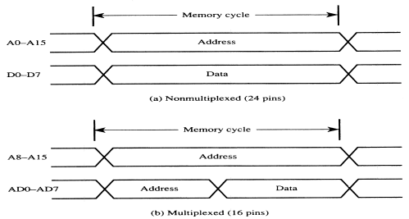
Address Multiplexing for External Memory
Figure 2-7
Multiplexing the address (low-byte) and data bus

Slide 34
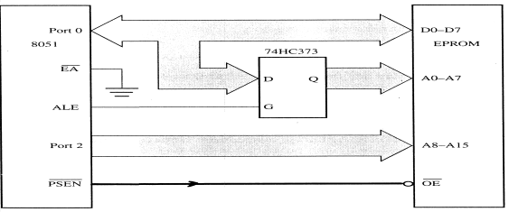
Address Multiplexing for External Memory
Figure 2-8
Accessing external code memory

Slide 35
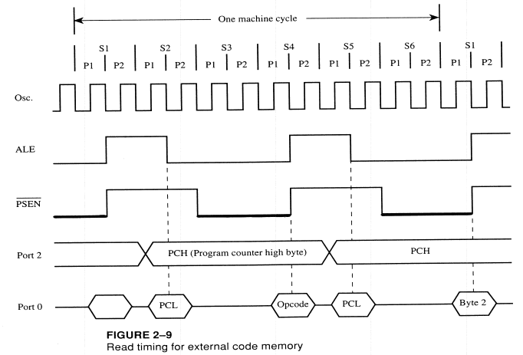

Slide 36
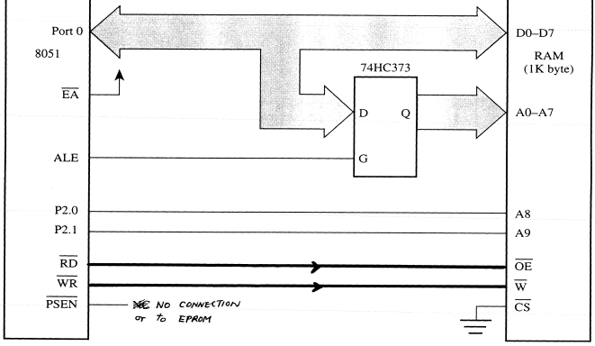
Accessing External
Data Memory
Figure 2-11
Interface to 1K RAM

Slide 37
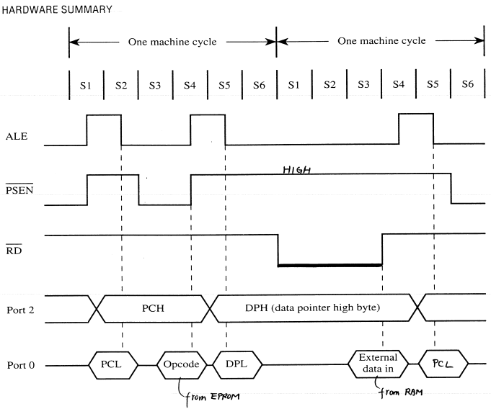
Timing for MOVX instruction

Slide 38
External code memory
WR
RD
PSEN
OE
ALE
74LS373
CS
G
P0.0
P0.7
A0
A7
D
D0
D7
EA
P2.0
P2.7
A8
A15
8051
ROM

Slide 39
External data memory
WR
WR
RD
RD
PSEN
ALE
74LS373
CS
G
P0.0
P0.7
A0
A7
D
D0
D7
EA
P2.0
P2.7
A8
A15
8051
RAM

Slide 40
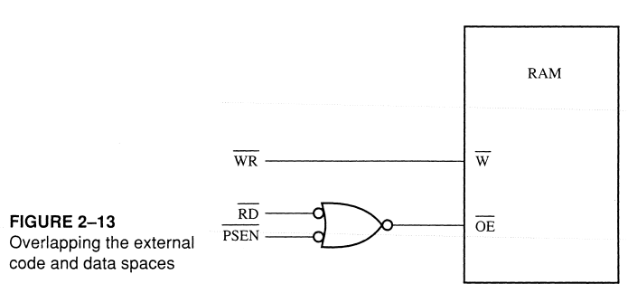
Overlapping External Code and Data Spaces

Slide 41
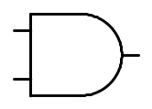
Overlapping External Code and Data Spaces
WR
WR
RD
PSEN
RD
ALE
74LS373
CS
G
P0.0
P0.7
A0
A7
D
D0
D7
EA
P2.0
P2.7
A8
A15
8051
RAM

Slide 42
Overlapping External Code and Data Spaces
Allows the RAM to be
  written as data memory, and
  read as data memory as well as code memory.
This allows a program to be
  downloaded from outside into the RAM as data, and
  executed from RAM as code.

Slide 43
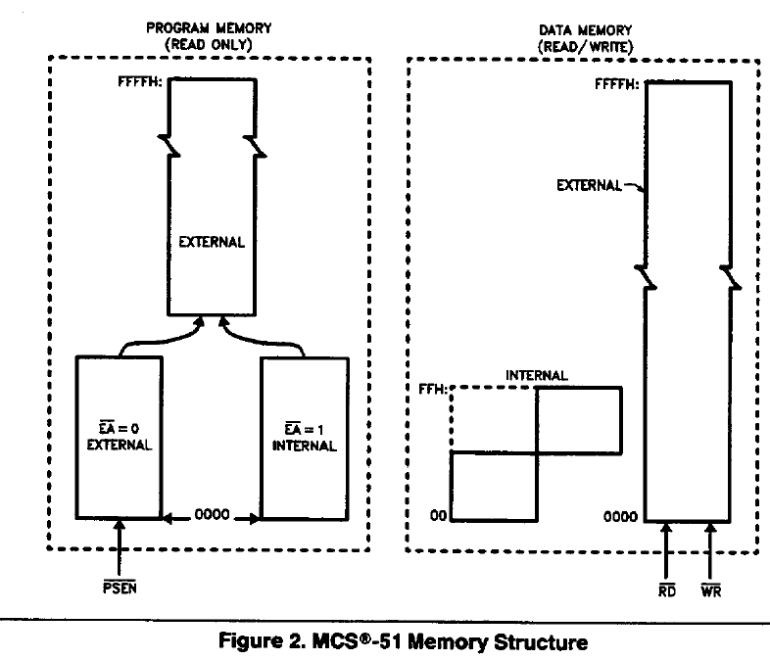

Slide 44
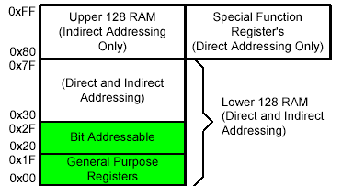
On-Chip Memory
Internal RAM

Slide 45
Registers
1F
18
Bank 3
Four Register Banks
Each bank has R0-R7
Selectable by psw.2,3
17
10
Bank 2
0F
08
Bank 1
07
06
05
04
03
02
01
00
R7
R6
R5
R4
R3
R2
R1
R0
Bank 0

Slide 46
Bit Addressable Memory
2F
2E
2D
2C
2B
2A
29
28
7F |  |  |  |  |  |  | 78
 |  |  |  |  | 1A
 |  |  |  |  |  |  | 10
0F |  |  |  |  |  |  | 08
07 | 06 | 05 | 04 | 03 | 02 | 01 | 00
20h – 2Fh (16 locations X 8-bits = 128 bits)
Bit addressing:
mov C, 1Ah
or
mov C, 23h.2
27
26
25
24
23
22
21
20

Slide 47
Special Function Registers
DATA registers
CONTROL registers
  Timers
  Serial ports
  Interrupt system
  Analog to Digital converter
  Digital to Analog converter
  Etc.
Addresses 80h – FFh
Direct Addressing used to access SPRs

Slide 48
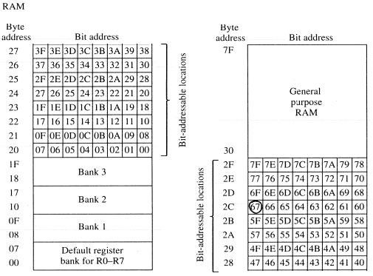
Bit Addressable RAM
Figure 2-6
Summary of the 8051 on-chip data memory
(RAM)

Slide 49
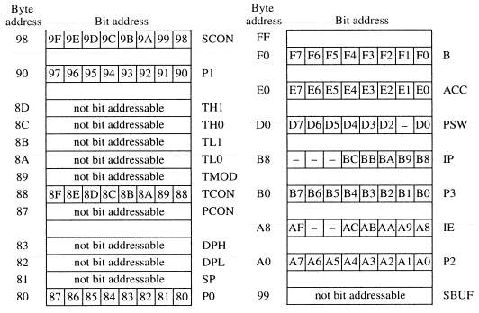
Bit Addressable RAM
Figure 2-6
Summary of the 8051 on-chip data memory
(Special Function Registers)

Slide 50
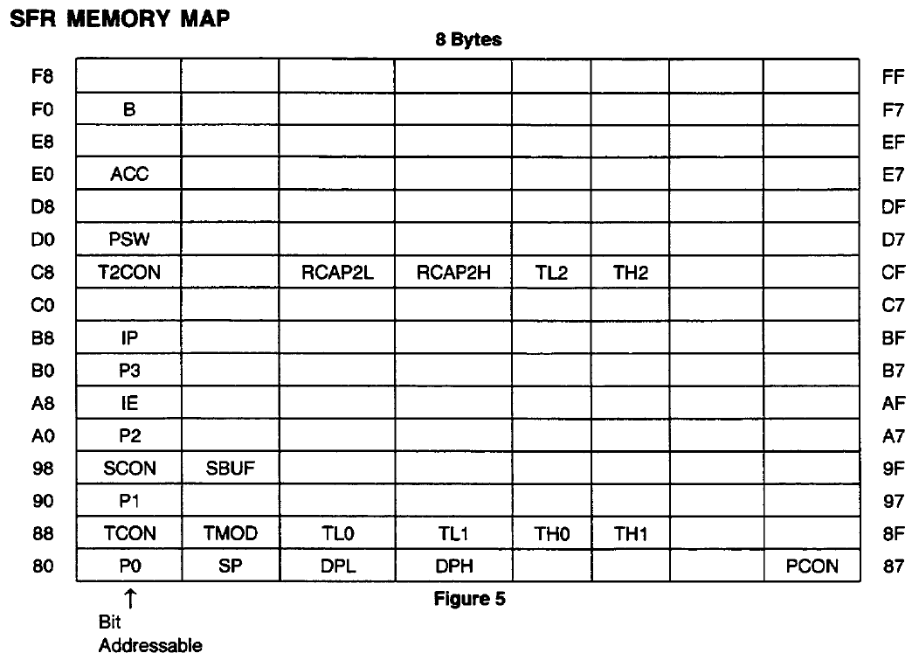

Slide 51
Register Banks
Active bank selected by PSW [RS1,RS0] bit
Permits fast “context switching” in interrupt service routines (ISR).

Slide 52
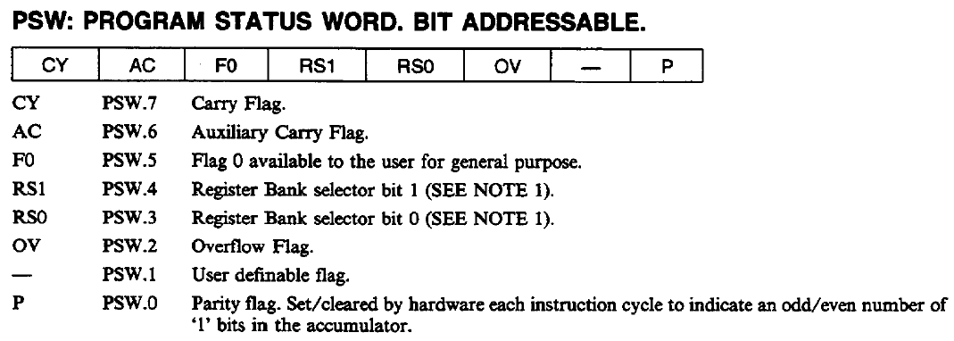
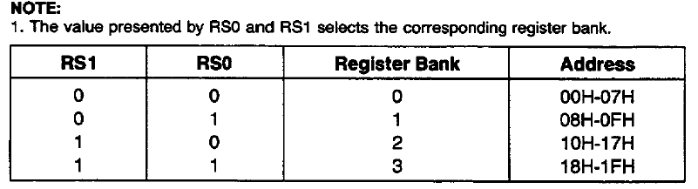

Slide 53
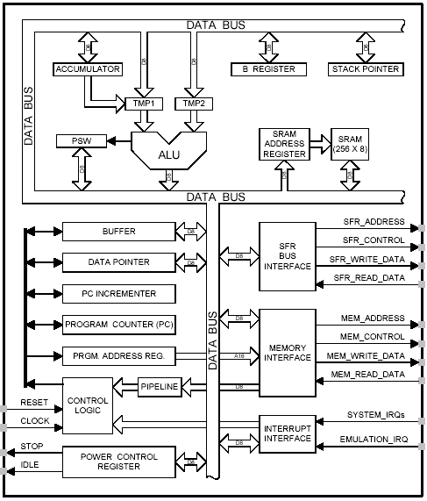
8051 CPU Registers
A (Accumulator)
B
PSW (Program Status Word)
SP (Stack Pointer)
PC (Program Counter)
DPTR (Data Pointer)
Used in assembler instructions

Slide 54
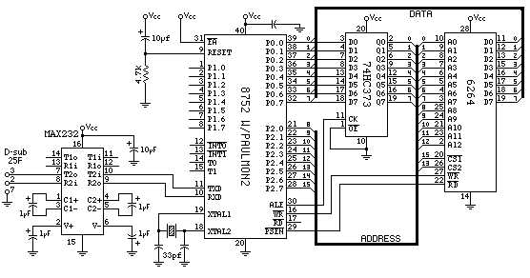
Registers

Slide 55
Registers
A
B
R0
DPTR
DPH
DPL
R1
R2
PC
PC
R3
R4
Some 8051 16-bit Register
R5
R6
R7
Some 8-bit Registers of the 8051

Slide 56
The 8051
Assembly Language

Slide 57
Overview
Data transfer instructions
Addressing modes
Data processing (arithmetic and logic)
Program flow instructions

Slide 58
Data Transfer Instructions
MOV dest, source dest ← source
Stack instructions
  PUSH byte ;increment stack pointer, ;move byte on stack
  POP byte ;move from stack to byte, ;decrement stack pointer
Exchange instructions
  XCH a, byte ;exchange accumulator and byte
  XCHD a, byte ;exchange low nibbles of ;accumulator and byte

Slide 59
Addressing Modes
Immediate Mode – specify data by its value
  mov A, #0 ;put 0 in the accumulator
  ;A = 00000000
  mov R4, #11h ;put 11hex in the R4 register
  ;R4 = 00010001
  mov B, #11 ;put 11 decimal in b register
  ;B = 00001011
  mov DPTR,#7521h ;put 7521 hex in DPTR
  ;DPTR = 0111010100100001

Slide 60
Addressing Modes
Immediate Mode – continue
    MOV DPTR,#7521h
    MOV DPL,#21H
    MOV DPH, #75
    COUNT EGU 30
    ~
    ~
    mov R4, #COUNT
    MOV DPTR,#MYDATA
    ~
    ~
    0RG 200H
MYDATA:DB “IRAN”

Slide 61
Addressing Modes
Register Addressing – either source or destination is one of CPU register
MOV R0,A
  MOV A,R7
  ADD A,R4
  ADD A,R7
  MOV DPTR,#25F5H
  MOV R5,DPL
  MOV R,DPH
Note that MOV R4,R7 is incorrect

Slide 62
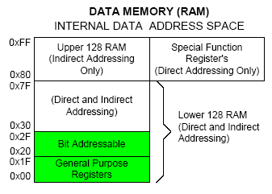
Addressing Modes
Direct Mode – specify data by its 8-bit address
Usually for 30h-7Fh of RAM
  Mov a, 70h ; copy contents of RAM at 70h to a
  Mov R0,40h ; copy contents of RAM at 70h to a
  Mov 56h,a ; put contents of a at 56h to a
  Mov 0D0h,a ; put contents of a into PSW

Slide 63
Addressing Modes
Direct Mode – play with R0-R7 by direct address
  MOV A,4 ≡ MOV A,R4
  MOV A,7 ≡ MOV A,R7
  MOV 7,2 ≡ MOV R7,R6
  MOV R2,#5 ;Put 5 in R2
  MOV R2,5 ;Put content of RAM at 5 in R2

Slide 64
Addressing Modes
Register Indirect – the address of the source or destination is specified in registers
Uses registers R0 or R1 for 8-bit address:
  mov psw, #0 ; use register bank 0
  mov r0, #0x3C
  mov @r0, #3 ; memory at 3C gets #3
  ; M[3C] ← 3
Uses DPTR register for 16-bit addresses:
  mov dptr, #0x9000 ; dptr ← 9000h
  movx a, @dptr ; a ← M[9000]
  Note that 9000 is an address in external memory

Slide 65
Use Register Indirect to access upper RAM block (+8052)

Slide 66
Addressing Modes
Register Indexed Mode – source or destination address is the sum of the base address and the accumulator(Index)
Base address can be DPTR or PC
    mov dptr, #4000h
    mov a, #5
    movc a, @a + dptr ;a ← M[4005]

Slide 67
Addressing Modes
Register Indexed Mode continue
Base address can be DPTR or PC
ORG 1000h
    1000 mov a, #5
    movc a, @a + PC ;a ← M[1008]
    Nop
Table Lookup
MOVC only can read internal code memory
PC

Slide 68
Acc Register
A register can be accessed by direct and register mode
This 3 instruction has same function with different code
    0703 E500 mov a,00h
    0705 8500E0 mov acc,00h
    0708 8500E0 mov 0e0h,00h
Also this 3 instruction
    070B E9 mov a,r1
    070C 89E0 mov acc,r1
    070E 89E0 mov 0e0h,r1

Slide 69
SFRs Address
B – always direct mode - except in MUL & DIV
  0703 8500F0 mov b,00h
  0706 8500F0 mov 0f0h,00h
  0709 8CF0 mov b,r4
  070B 8CF0 mov 0f0h,r4
P0~P3 – are direct address
  0704 F580 mov p0,a
  0706 F580 mov 80h,a
  0708 859080 mov p0,p1
Also other SFRs (pcon, tmod, psw,….)

Slide 70
SFRs Address
All SFRs such as
(ACC, B, PCON, TMOD, PSW, P0~P3, …)
are accessible by name and direct address
But
both of them
Must be coded as direct address

Slide 71
8051 Instruction Format
immediate addressing
    add a,#3dh ;machine code=243d
Direct addressing
    mov r3,0E8h ;machine code=ABE8
Op code
Immediate data
Op code
Direct address

Slide 72
8051 Instruction Format
Register addressing
  070D E8 mov a,r0 ;E8 = 1110 1000
  070E E9 mov a,r1 ;E9 = 1110 1001
  070F EA mov a,r2 ;EA = 1110 1010
  0710 ED mov a,r5 ;ED = 1110 1101
  0711 EF mov a,r7 ;Ef = 1110 1111
  0712 2F add a,r7
  0713 F8 mov r0,a
  0714 F9 mov r1,a
  0715 FA mov r2,a
  0716 FD mov r5,a
  0717 FD mov r5,a
Op code | n | n | n

Slide 73
8051 Instruction Format
Register indirect addressing
  mov a, @Ri ; i = 0 or 1
  070D E7 mov a,@r1
  070D 93 movc a,@a+dptr
  070E 83 movc a,@a+pc
  070F E0 movx a,@dptr
  0710 F0 movx @dptr,a
  0711 F2 movx @r0,a
  0712 E3 movx a,@r1
Op code | i

Slide 74
8051 Instruction Format
relative addressing
  here: sjmp here ;machine code=80FE(FE=-2)
  Range = (-128 ~ 127)
Absolute addressing (limited in 2k current mem block)
  0700 1 org 0700h
  0700 E106 2 ajmp next ;next=706h
  0702 00 3 nop
  0703 00 4 nop
  0704 00 5 nop
  0705 00 6 nop
  7 next:
  8 end
Op code
Relative address
A10-A8 | Op code
A7-A0
07FEh

Slide 75
8051 Instruction Format
Long distance address
  Range = (0000h ~ FFFFh)
  0700 1 org 0700h
  0700 020707 2 ajmp next ;next=0707h
  0703 00 3 nop
  0704 00 4 nop
  0705 00 5 nop
  0706 00 6 nop
  7 next:
  8 end
Op code
A15-A8
A7-A0

Slide 76
Stacks
pop
push
stack pointer
stack
Go do the stack exercise…..

Slide 77
Stack
Stack-oriented data transfer
  Only one operand (direct addressing)
  SP is other operand – register indirect - implied
Direct addressing mode must be used in Push and Pop
  mov sp, #0x40 ; Initialize SP
  push 0x55 ; SP ← SP+1, M[SP] ← M[55]
  ; M[41] ← M[55]
  pop b ; b ← M[55]
Note: can only specify RAM or SFRs (direct mode) to push or pop. Therefore, to push/pop the accumulator, must use acc, not a

Slide 78
Stack (push,pop)
Therefore
    Push a ;is invalid
    Push r0 ;is invalid
    Push r1 ;is invalid
    push acc ;is correct
    Push psw ;is correct
    Push b ;is correct
    Push 13h
    Push 0
    Push 1
    Pop 7
    Pop 8
    Push 0e0h ;acc
    Pop 0f0h ;b

Slide 79
Exchange Instructions
two way data transfer
  XCH a, 30h ; a ←→ M[30]
  XCH a, R0 ; a ←→ R0
  XCH a, @R0 ; a ←→ M[R0]
  XCHD a, R0 ; exchange “digit”
a[7..4] a[3..0]
R0[7..4] R0[3..0]
Only 4 bits exchanged

Slide 80
Bit-Oriented Data Transfer
transfers between individual bits.
Carry flag (C) (bit 7 in the PSW) is used as a single-bit accumulator
RAM bits in addresses 20-2F are bit addressable
mov C, P0.0
mov C, 67h
mov C, 2ch.7

Slide 81
SFRs that are Bit Addressable
SFRs with addresses ending in 0 or 8 are bit-addressable.
  (80, 88, 90, 98, etc)
Notice that all 4 parallel I/O ports are bit addressable.

Slide 82
Data Processing Instructions
Arithmetic Instructions
Logic Instructions

Slide 83
Arithmetic Instructions
Add
Subtract
Increment
Decrement
Multiply
Divide
Decimal adjust

Slide 84
Arithmetic Instructions
Mnemonic | Description
ADD A, byte | add A to byte, put result in A
ADDC A, byte | add with carry
SUBB A, byte | subtract with borrow
INC A | increment A
INC byte | increment byte in memory
INC DPTR | increment data pointer
DEC A | decrement accumulator
DEC byte | decrement byte
MUL AB | multiply accumulator by b register
DIV AB | divide accumulator by b register
DA A | decimal adjust the accumulator

Slide 85
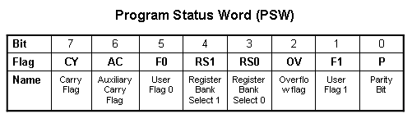
ADD Instructions
add a, byte ; a ← a + byte
addc a, byte ; a ← a + byte + C
These instructions affect 3 bits in PSW:
C = 1 if result of add is greater than FF
AC = 1 if there is a carry out of bit 3
OV = 1 if there is a carry out of bit 7, but not from bit 6, or visa versa.

Slide 86
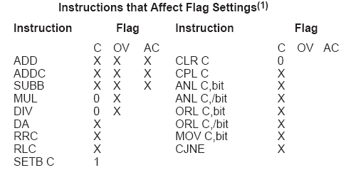
Instructions that Affect PSW bits

Slide 87
ADD Examples
mov a, #3Fh
add a, #D3h
What is the value of the C, AC, OV flags after the second instruction is executed?
0011 1111
1101 0011
0001 0010
C = 1
AC = 1
OV = 0

Slide 88
Signed Addition and Overflow
0111 1111 (positive 127)
0111 0011 (positive 115)
1111 0010 (overflow cannot represent 242 in 8 bits 2’s complement)
2’s complement:
0000 0000 00 0
…
0111 1111 7F 127
1000 0000 80 -128
…
1111 1111 FF -1
1000 1111 (negative 113)
1101 0011 (negative 45)
0110 0010 (overflow)
0011 1111 (positive)
1101 0011 (negative)
0001 0010 (never overflows)

Slide 89
Addition Example
; Computes Z = X + Y
; Adds values at locations 78h and 79h and puts them in 7Ah
;------------------------------------------------------------------
X equ 78h
Y equ 79h
Z equ 7Ah
;-----------------------------------------------------------------
org 00h
ljmp Main
;-----------------------------------------------------------------
org 100h
Main:
mov a, X
add a, Y
mov Z, a
end

Slide 90
The 16-bit ADD example
; Computes Z = X + Y (X,Y,Z are 16 bit)
;------------------------------------------------------------------
X equ 78h
Y equ 7Ah
Z equ 7Ch
;-----------------------------------------------------------------
org 00h
ljmp Main
;-----------------------------------------------------------------
org 100h
Main:
mov a, X
add a, Y
mov Z, a
mov a, X+1
adc a, Y+1
mov Z+1, a
end

Slide 91
Subtract
SUBB A, byte | subtract with borrow
Example:
SUBB A, #0x4F ;A ← A – 4F – C
Notice that
There is no subtraction WITHOUT borrow.
Therefore, if a subtraction without borrow is desired,
it is necessary to clear the C flag.
Example:
Clr c
SUBB A, #0x4F ;A ← A – 4F

Slide 92
Increment and Decrement
INC A | increment A
INC byte | increment byte in memory
INC DPTR | increment data pointer
DEC A | decrement accumulator
DEC byte | decrement byte
The increment and decrement instructions do NOT affect the C flag.
Notice we can only INCREMENT the data pointer, not decrement.

Slide 93
Example: Increment 16-bit Word
Assume 16-bit word in R3:R2
mov a, r2
add a, #1 ; use add rather than increment to affect C
mov r2, a
mov a, r3
addc a, #0 ; add C to most significant byte
mov r3, a

Slide 94
Multiply
When multiplying two 8-bit numbers, the size of the maximum product is 16-bits
FF x FF = FE01
(255 x 255 = 65025)
MUL AB ; BA ← A * B
Note : B gets the High byte
A gets the Low byte

Slide 95
Division
Integer Division
DIV AB ; divide A by B
A ← Quotient(A/B)
B ← Remainder(A/B)
OV - used to indicate a divide by zero condition.
C – set to zero

Slide 96
Decimal Adjust
DA a ; decimal adjust a
Used to facilitate BCD addition.
Adds “6” to either high or low nibble after an addition
to create a valid BCD number.
Example:
mov a, #23h
mov b, #29h
add a, b ; a ← 23h + 29h = 4Ch (wanted 52)
DA a ; a ← a + 6 = 52

Slide 97
Logic Instructions
Bitwise logic operations
  (AND, OR, XOR, NOT)
Clear
Rotate
Swap
Logic instructions do NOT affect the flags in PSW

Slide 98
Bitwise Logic
Examples:
ANL ➔ AND
ORL ➔ OR
XRL ➔ XOR
CPL ➔ Complement
00001111
10101100
ANL
00001100
00001111
10101100
ORL
10101111
00001111
10101100
XRL
10100011
CPL
10101100
01010011

Slide 99
Address Modes with Logic
ANL – AND
ORL – OR
XRL – eXclusive oR
CPL – Complement
a, byte
direct, reg. indirect, reg, immediate
byte, a
direct
byte, #constant
a ex: cpl a

Slide 100
Uses of Logic Instructions
Force individual bits low, without affecting other bits.
anl PSW, #0xE7 ;PSW AND 11100111
Force individual bits high.
orl PSW, #0x18 ;PSW OR 00011000
Complement individual bits
xrl P1, #0x40 ;P1 XRL 01000000

Slide 101
Other Logic Instructions
CLR - clear
RL – rotate left
RLC – rotate left through Carry
RR – rotate right
RRC – rotate right through Carry
SWAP – swap accumulator nibbles

Slide 102
CLR ( Set all bits to 0)
CLR A
CLR byte (direct mode)
CLR Ri (register mode)
CLR @Ri (register indirect mode)

Slide 103
Rotate
Rotate instructions operate only on a
RL a
Mov a,#0xF0 ; a← 11110000
RR a ; a← 11100001
RR a
Mov a,#0xF0 ; a← 11110000
RR a ; a← 01111000

Slide 104
Rotate through Carry
C
RRC a
mov a, #0A9h ; a ← A9
add a, #14h ; a ← BD (10111101), C←0
rrc a ; a ← 01011110, C←1
RLC a
mov a, #3ch ; a ← 3ch(00111100)
setb c ; c ← 1
rlc a ; a ← 01111001, C←1
C

Slide 105
Rotate and Multiplication/Division
Note that a shift left is the same as multiplying by 2, shift right is divide by 2
  mov a, #3 ; A← 00000011 (3)
  clr C ; C← 0
  rlc a ; A← 00000110 (6)
  rlc a ; A← 00001100 (12)
  rrc a ; A← 00000110 (6)

Slide 106
Swap
SWAP a
mov a, #72h ; a ← 27h
swap a ; a ← 27h

Slide 107
Bit Logic Operations
Some logic operations can be used with single bit operands
  ANL C, bit
  ORL C, bit
  CLR C
  CLR bit
  CPL C
  CPL bit
  SETB C
  SETB bit
“bit” can be any of the bit-addressable RAM locations or SFRs.

Slide 108
Shift/Mutliply Example
Program segment to multiply by 2 and add 1.

Slide 109
Program Flow Control
Unconditional jumps (“go to”)
Conditional jumps
Call and return

Slide 110
Unconditional Jumps
SJMP <rel addr> ; Short jump, relative address is 8-bit 2’s complement number, so jump can be up to 127 locations forward, or 128 locations back.
LJMP <address 16> ; Long jump
AJMP <address 11> ; Absolute jump to anywhere within 2K block of program memory
JMP @A + DPTR ; Long indexed jump

Slide 111
Infinite Loops
Start: mov C, p3.7
mov p1.6, C
sjmp Start
Microcontroller application programs are almost always infinite loops!

Slide 112
Re-locatable Code
Memory specific NOT Re-locatable (machine code)
  org 8000h
  Start: mov C, p1.6
  mov p3.7, C
  ljmp Start
  end
Re-locatable (machine code)
  org 8000h
  Start: mov C, p1.6
  mov p3.7, C
  sjmp Start
  end

Slide 113
Jump table
Mov dptr,#jump_table
Mov a,#index_number
Rl a
Jmp @a+dptr
...
Jump_table: ajmp case0
ajmp case1
ajmp case2
ajmp case3

Slide 114
Conditional Jump
These instructions cause a jump to occur only if a condition is true. Otherwise, program execution continues with the next instruction.
  loop: mov a, P1
  jz loop ; if a=0, goto loop, ; else goto next instruction
  mov b, a
There is no zero flag (z)
Content of A checked for zero on time

Slide 115
Conditional jumps
Mnemonic | Description
JZ <rel addr> | Jump if a = 0
JNZ <rel addr> | Jump if a != 0
JC <rel addr> | Jump if C = 1
JNC <rel addr> | Jump if C != 1
JB <bit>, <rel addr> | Jump if bit = 1
JNB <bit>,<rel addr> | Jump if bit != 1
JBC <bir>, <rel addr> | Jump if bit =1, &clear bit
CJNE A, direct, <rel addr> | Compare A and memory, jump if not equal

Slide 116
Example: Conditional Jumps
if (a = 0) is true
  send a 0 to LED
else
send a 1 to LED
      jz led_off
      Setb P1.6
      sjmp skipover
led_off: clr P1.6
      mov A, P0
skipover:

Slide 117
More Conditional Jumps
Mnemonic | Description
CJNE A, #data <rel addr> | Compare A and data, jump if not equal
CJNE Rn, #data <rel addr> | Compare Rn and data, jump if not equal
CJNE @Rn, #data <rel addr> | Compare Rn and memory, jump if not equal
DJNZ Rn, <rel addr> | Decrement Rn and then jump if not zero
DJNZ direct, <rel addr> | Decrement memory and then jump if not zero

Slide 118
Iterative Loops
For A = 0 to 4 do
{…}
clr a
loop: ...
...
inc a
cjne a, #4, loop
For A = 4 to 0 do
{…}
mov R0, #4
loop: ...
...
djnz R0, loop

Slide 119
Iterative Loops(examples)
mov a,#50h
mov b,#00h
cjne a,#50h,next
mov b,#01h
next: nop
end
mov a,#25h
mov r0,#10h
mov r2,#5
Again: mov @ro,a
inc r0
djnz r2,again
end
mov a,#0aah
mov b,#10h
Back1:mov r6,#50
Back2:cpl a
djnz r6,back2
djnz b,back1
end
mov a,#0h
mov r4,#12h
Back: add a,#05
djnz r4,back
mov r5,a
end

Slide 120
Call and Return
Call is similar to a jump, but
  Call pushes PC on stack before branching
acall <address ll> ; stack ← PC
; PC ← address 11 bit
lcall <address 16> ; stack ← PC
; PC ← address 16 bit

Slide 121
Return
Return is also similar to a jump, but
  Return instruction pops PC from stack to get address to jump to
    ret ; PC ← stack

Slide 122
Subroutines
call to the subroutine
Main: ...
acall sublabel
...
...
sublabel: ...
...
ret
the subroutine

Slide 123
Initializing Stack Pointer
SP is initialized to 07 after reset.(Same address as R7)
With each push operation 1st , pc is increased
When using subroutines, the stack will be used to store the PC, so it is very important to initialize the stack pointer. Location 2Fh is often used.
mov SP, #2Fh

Slide 124
Subroutine - Example
square: push b
mov b,a
mul ab
pop b
ret
8 byte and 11 machine cycle
square: inc a
movc a,@a+pc
ret
table: db 0,1,4,9,16,25,36,49,64,81
13 byte and 5 machine cycle

Slide 125
Subroutine – another example
; Program to compute square root of value on Port 3
; (bits 3-0) and output on Port 1.
org 0
ljmp Main
Main: mov P3, #0xFF ; Port 3 is an input
loop: mov a, P3
anl a, #0x0F ; Clear bits 7..4 of A
lcall sqrt
mov P1, a
sjmp loop
sqrt: inc a
movc a, @a + PC
ret
Sqrs: db 0,1,1,1,2,2,2,2,2,3,3,3,3,3,3,3
end
reset service
main program
subroutine
data

Slide 126
Why Subroutines?
Subroutines allow us to have "structured" assembly language programs.
This is useful for breaking a large design into manageable parts.
It saves code space when subroutines can be called many times in the same program.

Slide 127
example of delay
mov a,#0aah
Back1:mov p0,a
lcall delay1
cpl a
sjmp back1
Delay1:mov r0,#0ffh;1cycle
Here: djnz r0,here ;2cycle
ret ;2cycle
end
Delay=1+255*2+2=513 cycle
Delay2:
mov r6,#0ffh
back1: mov r7,#0ffh ;1cycle
Here: djnz r7,here ;2cycle
djnz r6,back1;2cycle ret ;2cycle
end
Delay=1+(1+255*2+2)*255+2
=130818 machine cycle

Slide 128
Long delay Example
GREEN_LED: equ P1.6
org ooh
ljmp Main
org 100h
Main: clr GREEN_LED
Again: acall Delay
cpl GREEN_LED
sjmp Again
Delay: mov R7, #02
Loop1: mov R6, #00h
Loop0: mov R5, #00h
djnz R5, $
djnz R6, Loop0
djnz R7, Loop1
ret
END
reset service
main program
subroutine

Slide 129
Example
; Move string from code memory to RAM
org 0
mov dptr,#string
mov r0,#10h
Loop1: clr a
movc a,@a+dptr
jz stop
mov @r0,a
inc dptr
inc r0
sjmp loop1
Stop: sjmp stop
; on-chip code memory used for string
org 18h
String: db ‘this is a string’,0
end

Slide 130
Example
; p0:input p1:output
mov a,#0ffh
mov p0,a
back: mov a,p0
mov p1,a
sjmp back
setb p1.2
mov a,#45h ;data
Again: jnb p1.2,again ;wait for data request
mov p0,a ;enable strobe
setb p2.3
clr p2.3

Slide 131
Example
; duty cycle 50%
back: cpl p1.2
acall delay
sjmp back
back: setb p1.2
acall delay
Clr p1.2
acall delay
sjmp back

Slide 132
Example
; duty cycle 66%
back: setb p1.2
acall delay
acall delay
Clr p1.2
acall delay
sjmp back

Slide 133
8051 timer

Slide 134
Interrupts
…
mov a, #2
mov b, #16
mul ab
mov R0, a
mov R1, b
mov a, #12
mov b, #20
mul ab
add a, R0
mov R0, a
mov a, R1
addc a, b
mov R1, a
end
interrupt
ISR: inc r7
mov a,r7
jnz NEXT
cpl P1.6
NEXT: reti
Program Execution
return

Slide 135
Interrupt Sources
Original 8051 has 5 sources of interrupts
  Timer 0 overflow
  Timer 1 overflow
  External Interrupt 0
  External Interrupt 1
  Serial Port events (buffer full, buffer empty, etc)
Enhanced version has 22 sources
  More timers, programmable counter array, ADC, more external interrupts, another serial port (UART)

Slide 136
Interrupt Process
If interrupt event occurs AND interrupt flag for that event is enabled, AND interrupts are enabled, then:
Current PC is pushed on stack.
Program execution continues at the interrupt vector address for that interrupt.
When a RETI instruction is encountered, the PC is popped from the stack and program execution resumes where it left off.

Slide 137
Interrupt Priorities
What if two interrupt sources interrupt at the same time?
The interrupt with the highest PRIORITY gets serviced first.
All interrupts have a default priority order.
Priority can also be set to “high” or “low”.

Slide 138
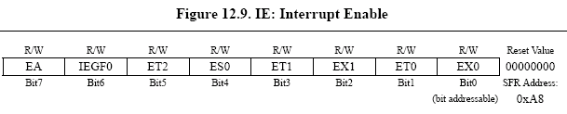
Interrupt SFRs
Interrupt enables for the 5 original 8051 interrupts:
Timer 2
Serial (UART0)
Timer 1
External 1
Timer 0
External 0
Global Interrupt Enable – must be set to 1 for any interrupt to be enabled
1 = Enable
0 = Disable

Slide 139
Interrupt Vectors
Each interrupt has a specific place in code memory where program execution (interrupt service routine) begins.
External Interrupt 0: 0003h
Timer 0 overflow: 000Bh
External Interrupt 1: 0013h
Timer 1 overflow: 001Bh
Serial : 0023h
Timer 2 overflow(8052+) 002bh
Note: that there are only 8 memory locations between vectors.

Slide 140
Interrupt Vectors
To avoid overlapping Interrupt Service routines, it is common to put JUMP instructions at the vector address. This is similar to the reset vector.
org 009B ; at EX7 vector
ljmp EX7ISR
cseg at 0x100 ; at Main program
Main: ... ; Main program
...
EX7ISR:... ; Interrupt service routine
... ; Can go after main program
reti ; and subroutines.

Slide 141
Example Interrupt Service Routine
;EX7 ISR to blink the LED 5 times.
;Modifies R0, R5-R7, bank 3.
;----------------------------------------------------
ISRBLK: push PSW ;save state of status word
mov PSW,#18h ;select register bank 3
mov R0, #10 ;initialize counter
Loop2: mov R7, #02h ;delay a while
Loop1: mov R6, #00h
Loop0: mov R5, #00h
djnz R5, $
djnz R6, Loop0
djnz R7, Loop1
cpl P1.6 ;complement LED value
djnz R0, Loop2 ;go on then off 10 times
pop PSW
reti

